Slide 1

End-to-end learned multi-view stereo reconstruction
Dongyue Lu, Zhisheng Zheng
Supervisor: Prof. Dr. Matthias Nießner
March 9, 2022
Notes:
Hello everyone, My name is Zhisheng and my partner is Dongyue. Welcome to our final presentation of this practical course. Our topic is End-to-end learned multi-view stereo reconstruction.

Slide 2
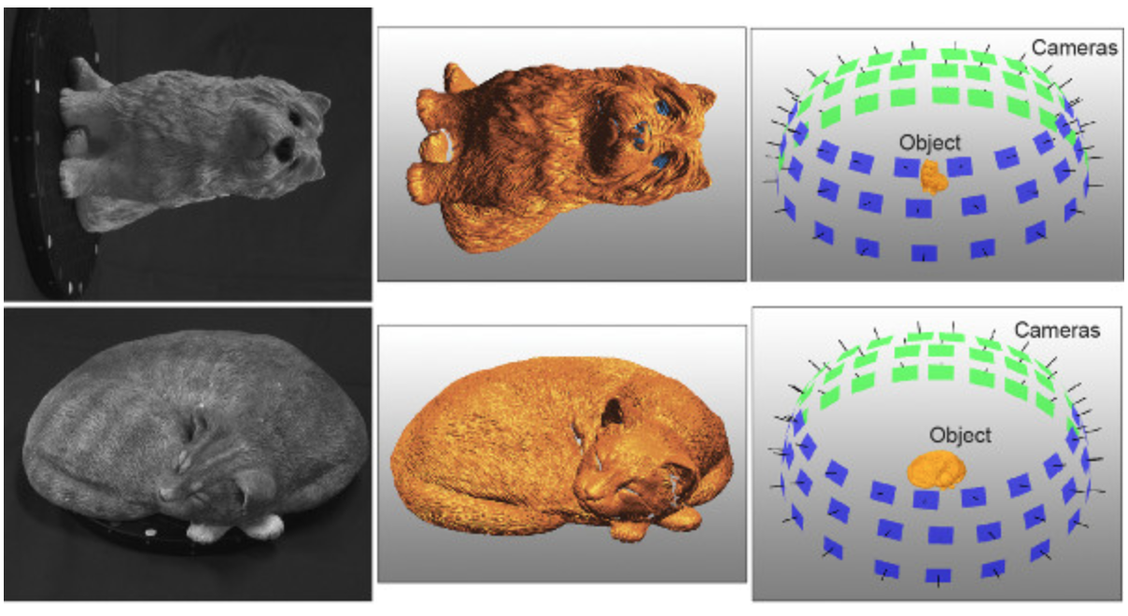
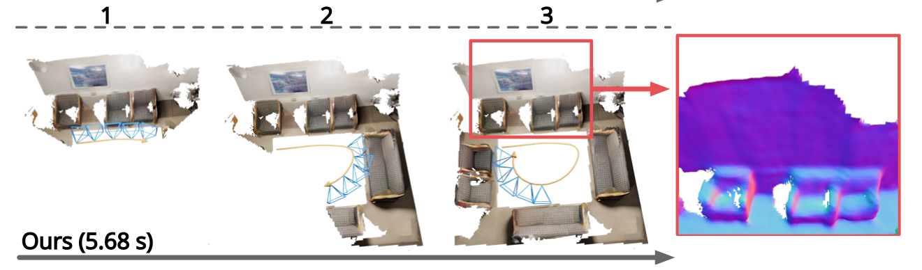


Introduction
Given a series of RGB images with the corresponding extrinsic/intrinsic matrix, the goal is to reconstruct the 3D model.
$${3D Object Reconstruction}^{[1]}$$
$${3D scene Reconstruction}^{[2]}$$
[1] Sakai S, Ito K, Aoki T, et al. Phase-based window matching with geometric correction for multi-view stereo[J]. IEICE TRANSACTIONS on Information and Systems, 2015, 98(10): 1818-1828.
[2] Sun J, Xie Y, Chen L, et al. NeuralRecon: Real-time coherent 3D reconstruction from monocular video[C]//Proceedings of the IEEE/CVF Conference on Computer Vision and Pattern Recognition. 2021: 15598-15607.
Notes:
Multi-view stereopsis (MVS) is a classic computer vision problem which aims to reconstruct a 3D model given a set of images with corresponding camera parameters. This technology is one of the key components of autonomous driving, augmented reality and target motion analysis. For example, in the simplest scenario, we have many photographs of the same object taken from different angles. Under conditions that all camera parameters are known, we can reconstruct this object offline and use the reconstructed object for downsample application. In a more complicated scenario, we have a monocular video of one indoor scene and what we want is use this video, camera poses, and intrinsic matrix to reconstruct the whole scene. Our project focus on the latter one.

Slide 3
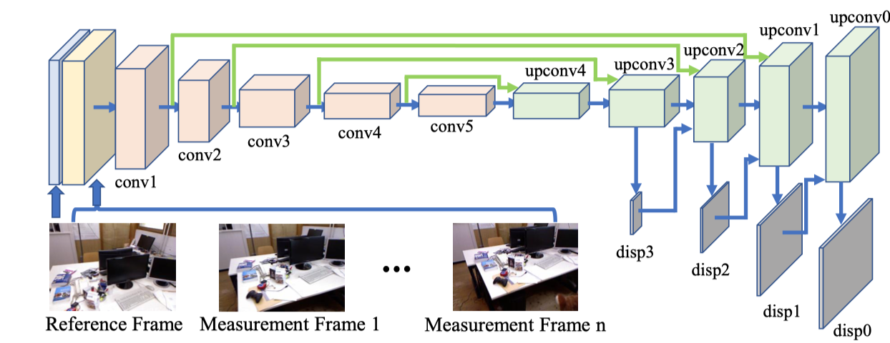
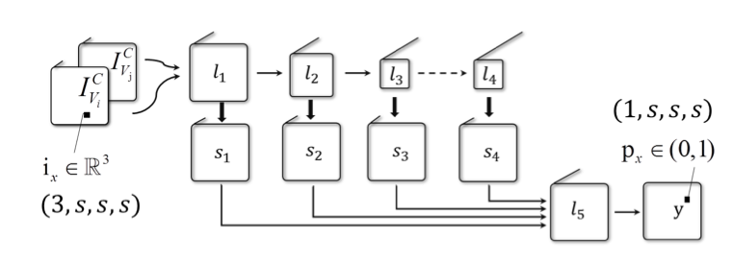
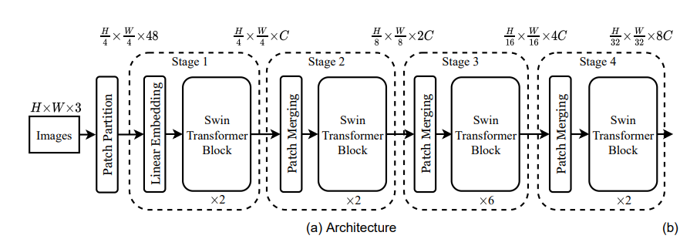
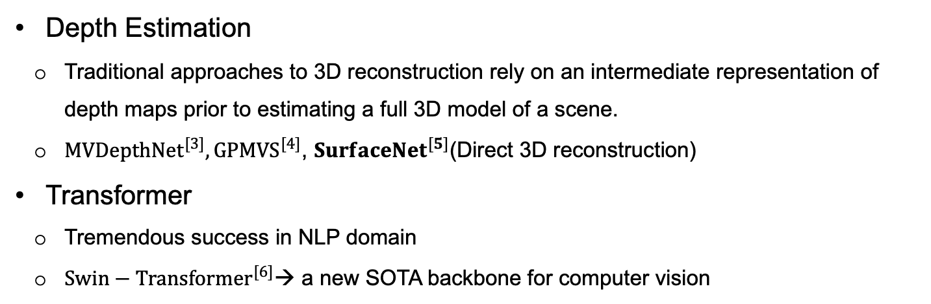
Related Work
Depth Estimation
Traditional approaches to 3D reconstruction rely on an intermediate representation of depth maps prior to estimating a full 3D model of a scene.
${MVDepthNet}^{[3]}, {GPMVS}^{[4]}$, ${SurfaceNet}^{[5]}$(Direct 3D reconstruction)
Transformer
Tremendous success in NLP domain
${Swin−Transformer}^{[6]}$→ a new SOTA backbone for computer vision
MVDepthNet
SurfaceNet
Swin-Transformer
[3] Wang K, Shen S. Mvdepthnet: Real-time multiview depth estimation neural network[C]//2018 International conference on 3d vision (3DV). IEEE, 2018: 248-257.
[4] Hou Y, Kannala J, Solin A. Multi-view stereo by temporal nonparametric fusion[C]//Proceedings of the IEEE/CVF International Conference on Computer Vision. 2019: 2651-2660.
[5] Ji M, Gall J, Zheng H, et al. Surfacenet: An end-to-end 3d neural network for multiview stereopsis[C]//Proceedings of the IEEE International Conference on Computer Vision. 2017: 2307-2315.
[6] Liu Z, Lin Y, Cao Y, et al. Swin transformer: Hierarchical vision transformer using shifted windows[C]//Proceedings of the IEEE/CVF International Conference on Computer Vision. 2021: 10012-10022.
Notes:
Many pioneering works have been proposed in this ﬁeld and one common method is to estimate the depth maps and fuse them into a 3D representations. A lot of deep-learning based model have been proposed, such as MVDepthNet [4] and GPMVS. However, It is difﬁcult for depth based method to consider the global priority even when many scenes overlap, Unlike depth based method, SurfaceNet [6] back-projects a series of images to 3D space, and then directly uses 3D CNN to process them and obtains the 3D reconstruction results, which is one of the basis of our Model.
Another topic, Transformer. Designed for sequence modeling. it has achieved tremendous success in NLP domain, which led researcher to dig its potential on computer vision. Swin-Transformer, one of the greatest achievement in transformer, has became a new sota backbone for computer vison.

Slide 4
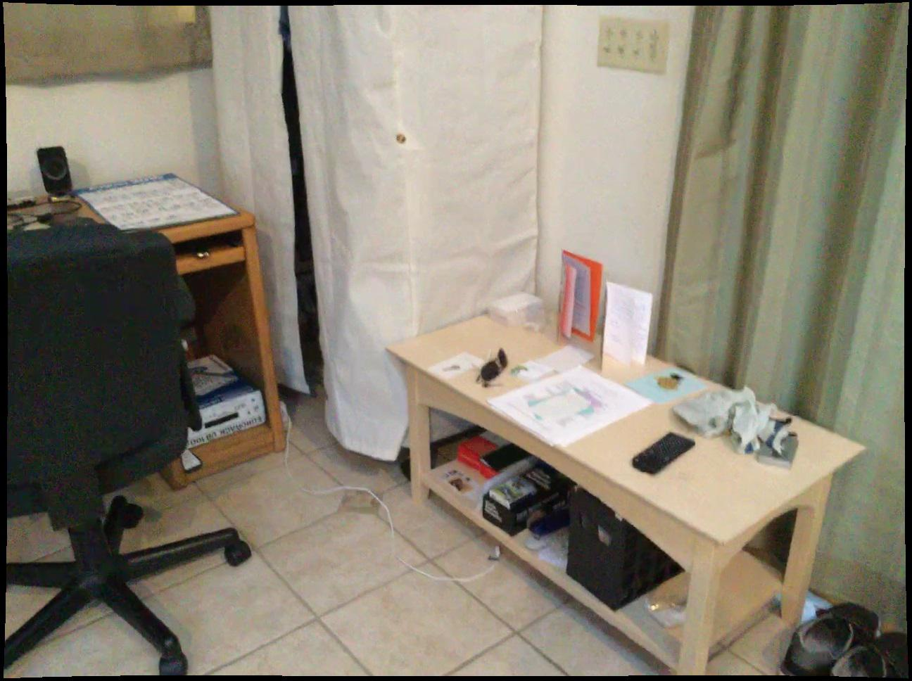
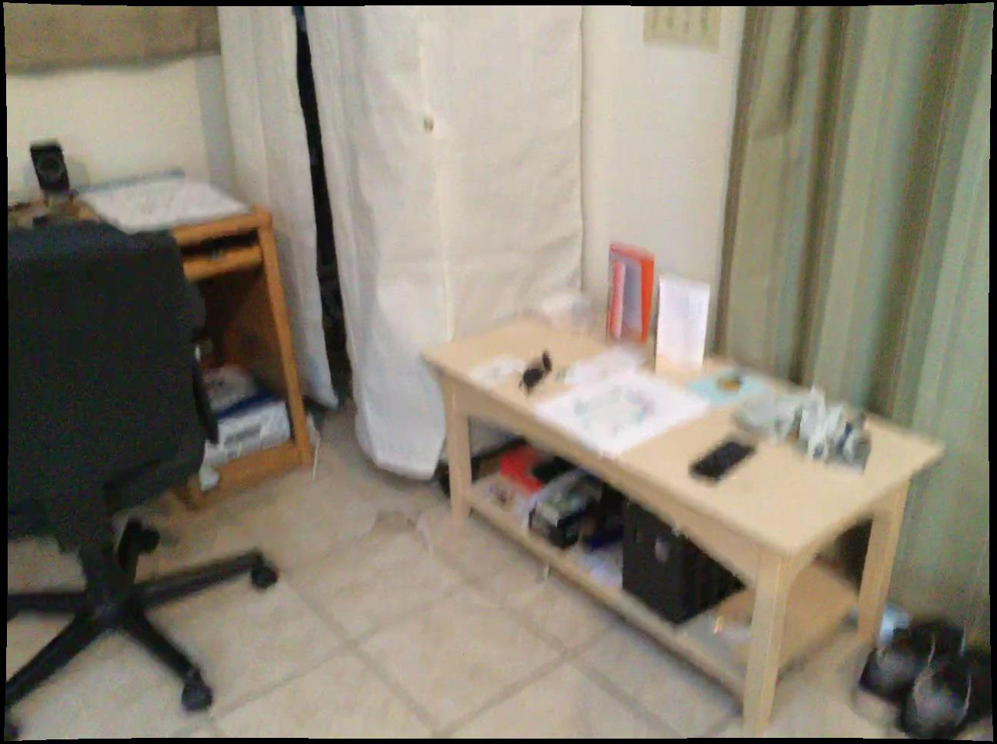
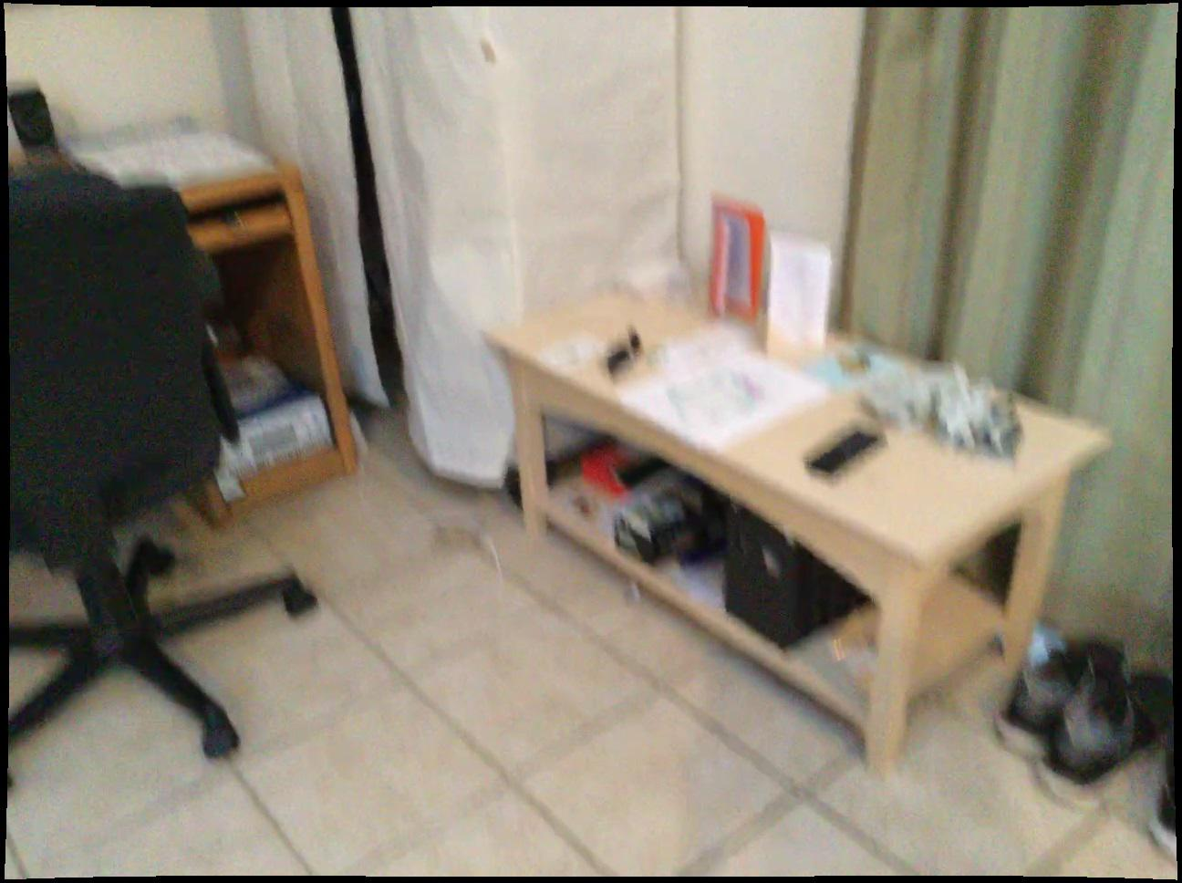
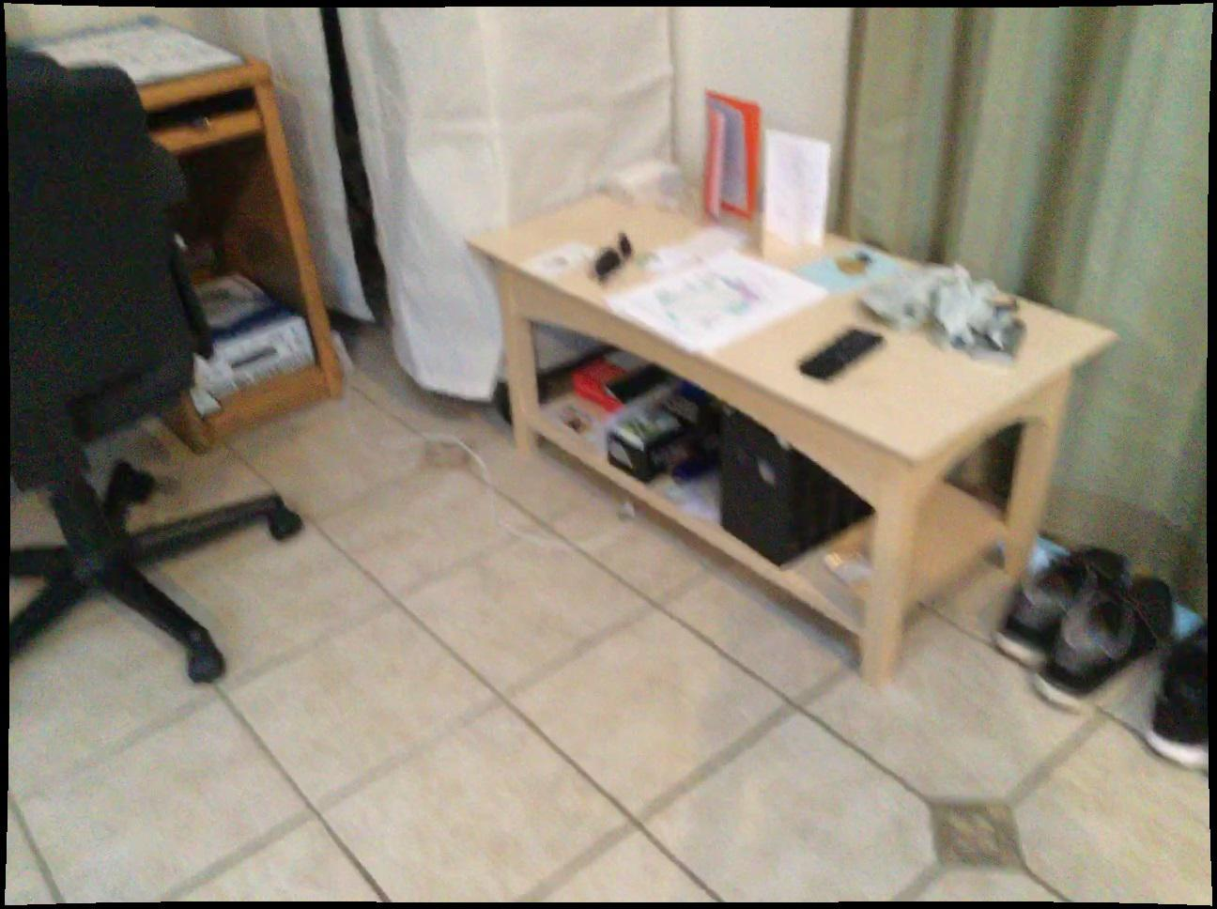
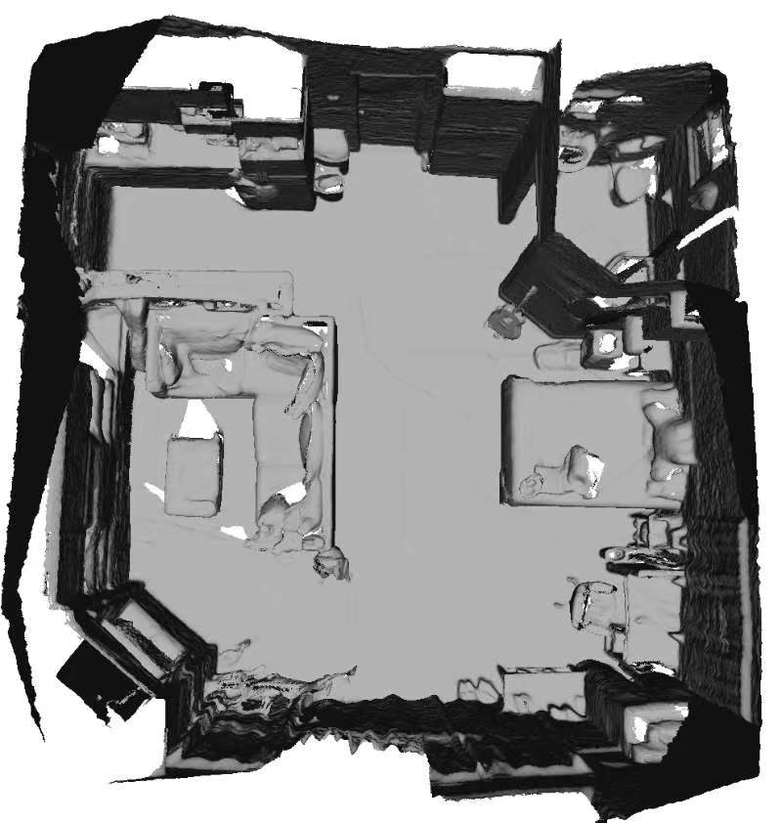
Proposed Method
Conv
Back
Projection
Fusion
Module
Coarse
Conv
Swin
Transformer
Backbone
Back
Projection
Fusion
Module
Conv
SPVConv
Conv
Conv
Back
Projection
Fusion
Module
RGB images
Fine
Output Scene
Notes:
This is the overall architecture of our model. Given a set of RGB images, we first use a swin-transformer backbone to extract its multi-level features, these features will be fused in a pyramid architecture and then backproject to 3D Voxels. We use a sparse 3D CNN called SPVConv to process these featured voxels and finally use one fusion module to concatenated them from coarse to fine.

Slide 5
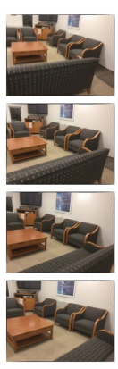
Proposed Method
Swin Transformer Backbone
shape: 24 x 120 x 160
shape: 48 x 60 x 80
shape: 96 x 30 x 40
Swin
Transformer
Block
Swin
Transformer
Block
Swin
Transformer
Block
Patch Partition
Linaer Embedding
Linaer Embedding
Linaer Embedding
x 2
x 3
x 4
3 x 480 x 640
Notes:
As shown in the figure, we use a classical swin-transformer structure, we first divided the image into many small patches without overlapping,after linear embedding they will be feed them into three layer with increasing number of swin transformer blocks to extract the features of different resolutions. These features will be further processed, fused and then back project to voxels for the input of SPVCNN.

Slide 6
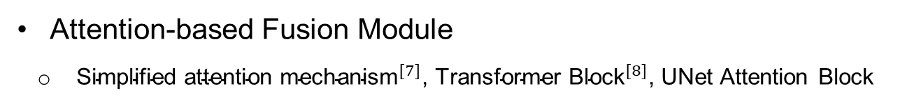
Proposed Method
Attention-based Fusion Module
${\text{Simplified} \text{attention} \text{mechanism}}^{[7]}$, ${\text{Transformer} \text{Block}}^{[8]}$, UNet Attention Block
volume at the same location, N*C
throw
volume at the same location
AttentionLayer/
Transformer/
UNet Attention Block
substitute
substitute
current volume
current volume, N*C
global volume
global volume
Direct Substitute
Attention-based Fusion Module
Notes:
In order to fuse different windows into one scene. after reconstructing the current window, in the global volume, we find the volume at the same location.
We pick out the coordinates of all occupied points, so the two volumes can be viewed as two sequences with equal length,
N is the number of points, and C is the length of the feature vector.
In order for the model to focus on features at more important locations when updating features,
we design three attention based fusion module to update features
For direct substitute method, we use it for ablation studies

Slide 7
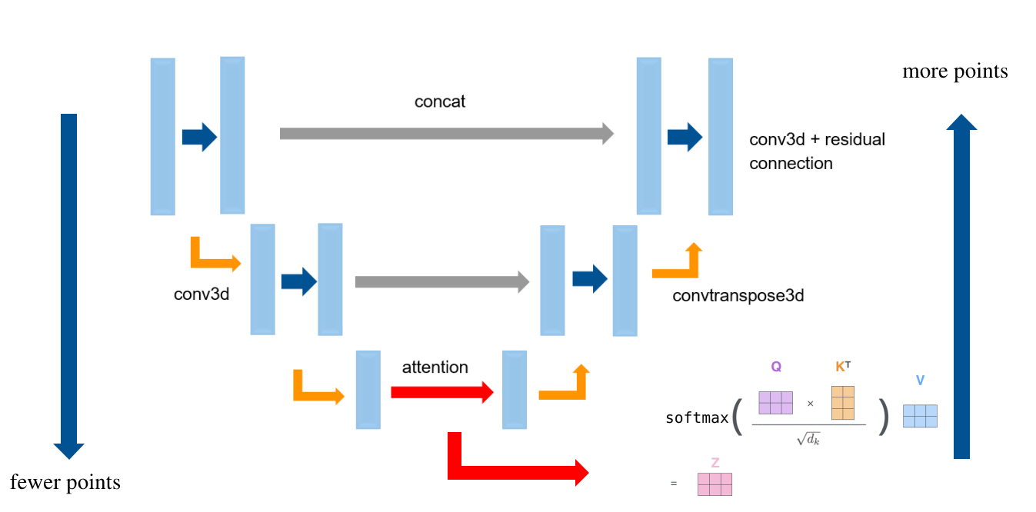
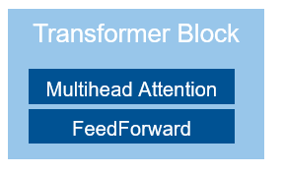
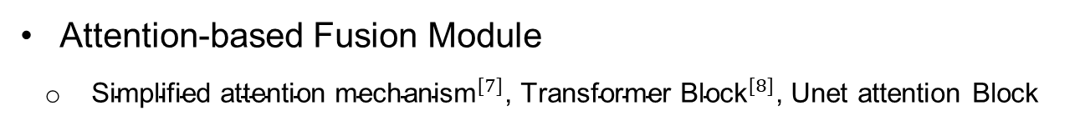
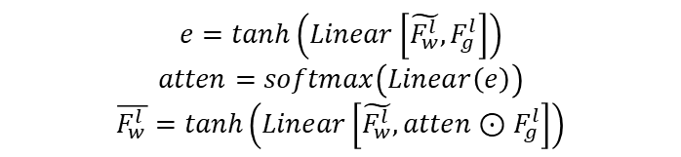
Proposed Method
Attention-based Fusion Module
${\text{Simplified} \text{attention} \text{mechanism}}^{[7]}$, ${\text{Transformer} \text{Block}}^{[8]}$, Unet attention Block
$$e=tanh\left(Linear\left[\tilde{F_{w}^{l}},F_{g}^{l}\right]\right)$$
$$atten=softmax\left(Linear\left(e\right)\right)$$
$$\overline{F_{w}^{l}}=tanh\left(Linear\left[\tilde{F_{w}^{l}},atten⊙F_{g}^{l}\right]\right)$$
Simplified Attention Mechanism
Transformer Block
Unet Attention Block
Loss Function
Weighted Binary Cross Entropy Loss for OCC and logarithm MAE in NeuralRecon for TSDF
[7] Bahdanau D, Cho K, Bengio Y. Neural machine translation by jointly learning to align and translate[J]. arXiv preprint arXiv:1409.0473, 2014.
[8] Vaswani A, Shazeer N, Parmar N, et al. Attention is all you need[J]. Advances in neural information processing systems, 2017, 30.
Notes:
We use three different attention-based fusion module to fuse the local feature state Fw and global feature state/or we can call it hidden state Fg. Given that the computation of the commonly used scaled dot product attention for long sequence data is really computational expensive, we first use a simplified attention mechanism shows on the left part of this slide. Second, we use the classical transformer block with 4 attention heads and a feed forward layer. Also, we change the original attention mechanism in it to this simplified mechanism. Last, we also designed a U-net shape attention block, at the bottom neck, we use the classical attention mechanism to process it.
For loss function, we use a weighted bce for occupancy loss and logarithm mae proposed in neuralrecon for tsdf loss

Slide 8
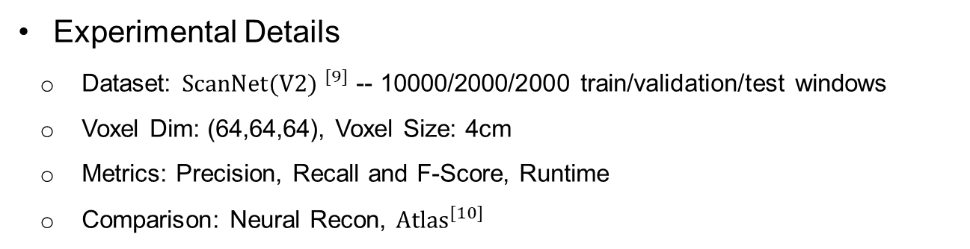
Experiments
Experimental Details
Dataset: ${ScanNet(V2) }^{[9]}$ -- 10000/2000/2000 train/validation/test windows
Voxel Dim: (64,64,64), Voxel Size: 4cm
Metrics: Precision, Recall and F-Score, Runtime
Comparison: Neural Recon, ${Atlas}^{[10]}$
[9] Angela Dai, Angel X Chang, Manolis Savva, Maciej Halber, Thomas Funkhouser, and Matthias Nießner. Scannet: Richly-annotated 3d reconstructions of indoor scenes. In Proceedings of the IEEE conference on computer vision and pattern recognition, pages 5828–5839, 2017
[10] Murez Z, As T, Bartolozzi J, et al. Atlas: End-to-end 3d scene reconstruction from posed images[C]//European Conference on Computer Vision. Springer, Cham, 2020: 414-431.
Notes:
We conduct a series of experiments on ScanNet dataset. Due to the limit of our computing resource, we select 10000/2000/2000 windows for training, validation and test.
The voxel has a dimension of 64 * 64 * 64 and its size is 4cm.
we consider 3D reconstruction metrics precision, recall and F score, and F score is our most reliable metric as both the accuracy and completeness are considered.
Due to time constraint, We compare our method with two state of the art methods: NeuralRecon and Atlas

Slide 9
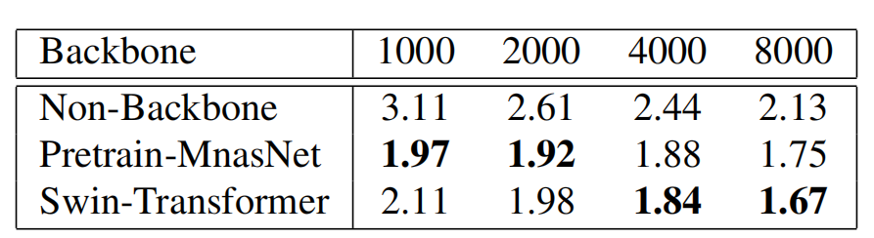
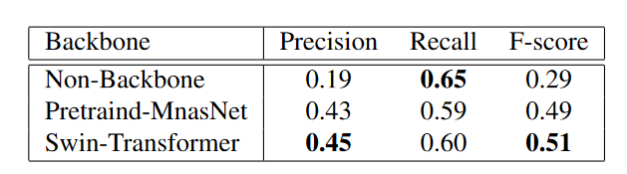
Backbone Selection
1000/200, 2000/500, 4000/1000, 8000/1600 (train/validation)
Table 1: Backbone Selection: Results on different training windows. The value in this table represents the corresponding validation loss
Table 2: Backbone Selection: Final evaluation of different backbones (8000 windows)
Notes:
To study the performance of Swin-Transformer as backbone, we ﬁrst conduct a series of experiments under increasing dataset size. In this stage, we don’t implement any fusion module. We compare Swin-Transformer with pre-trained MnasNet and a non-backbone scenario for ablation study, that means ,we back project color directly
As shown in the Table 1, there is a huge gap between the validation loss of direct-projection and feature-projection, verifying the effectiveness of a feature extraction process.
Comparing MnasNet with Swin-Transformer, it is clear that as the dataset size grows, the generalization of Swin-Transformer has a steady improvement, surpassing MnasNet.
Finally, we evaluate the quality of generated mesh in the 8000 windows case. from Table 2. The Swin-Transformer outperforms MnasNet on all metrics.

Slide 10
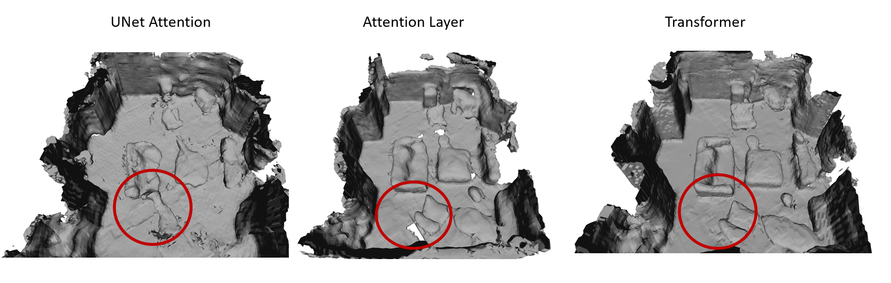
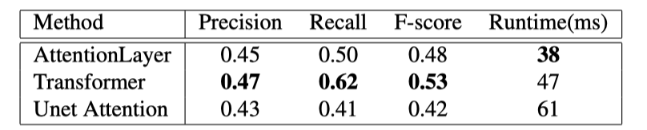
Fusion Module
Comparison between different fusion module
Figure 1: Reconstructed Scene –Fusion Module
Table 3: Fusion Module Comparison
Notes:
We further test the performance of three different fusion modules. it’s clear that the most complex architecture – Unet attention block, achieves the worst result. One possible reason is that, valuable information between two long sequences is lost after sampling,.
The transformer architecture achieves the best performance as we expect, since the multi head attention can focus on different aspects of sequence. achieve our expectation of combining the surrounding context, the reconstruction is smooth and consistent, while the Unet attention reconstruction is rough.
In terms of runtime, Unet attention is the slowest, but the transformer and attention-layer are both very fast.

Slide 11
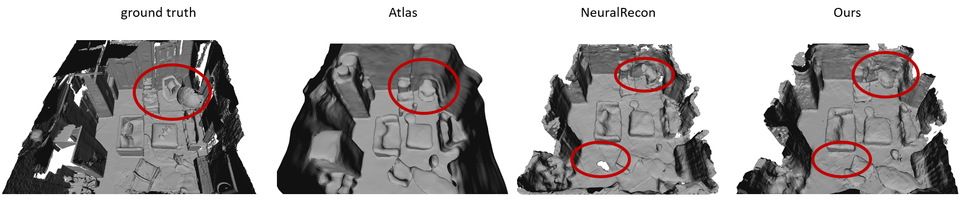
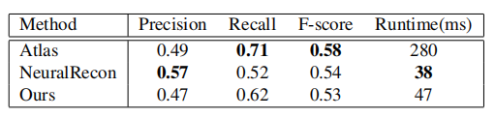
Fusion Module
Overall Performance
Figure 2: Reconstructed Scene – Overall Performance
Table 4: Overall Comparison
Notes:
In overall performance, our method has similar performance to NeuralRecon and even surpasses it in some scenes, for example in this scene, neural recon has more noise than our method, but both of us are worse than atlas. As an ofﬂine method, Atlas provides very smooth reconstruction, and even oversmoothed geometry, resulting in inaccurate reconstruction, like the circled region. Our method and NeuralRecon have generally good reconstruction quality with much higher speed compared to Atlas, here almost 7 times faster than atlas

Slide 12
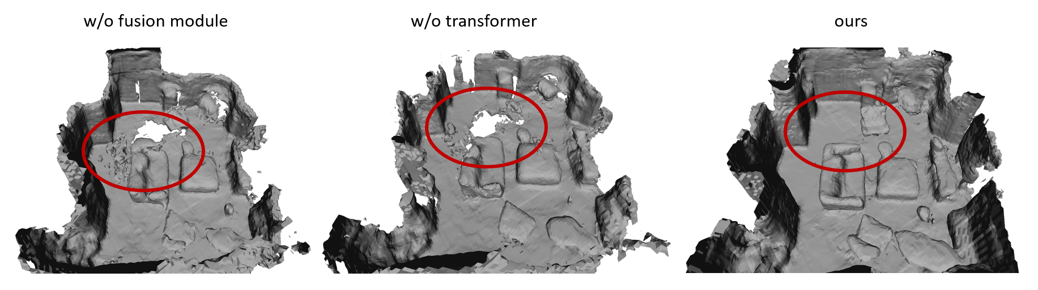
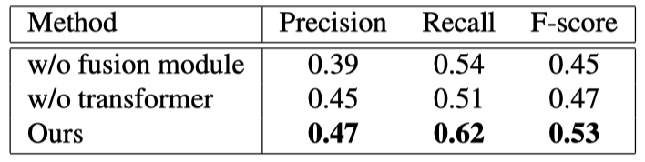
Ablation Study and Failure Case
Ablation study
Figure 3: Reconstructed Scene – Ablation Study
Table 5: Ablation Study
Notes:
we also conduct an ablation study to verify the effectiveness of fusion module. in the first experiment, we directly replace current global region with local region generated in this iteration.
In the second experiment, we add fusion module with a simple linear layer for information exchange. we can see the performance of both are worse than our transformer module, especially that the direct substitute method results are rough, which reﬂects the ability of our transformer module to consider the surrounding condition and context.

Slide 13
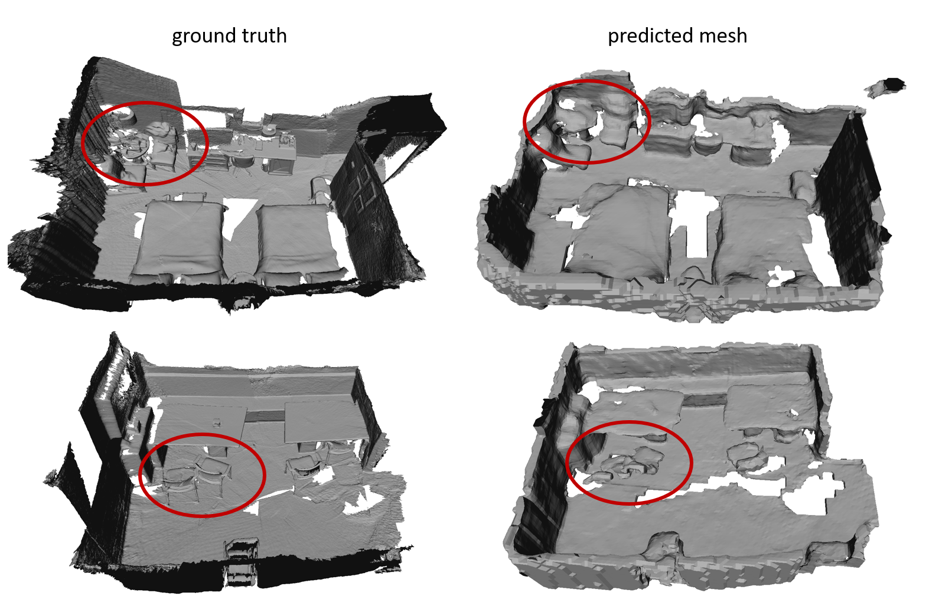
Ablation Study and Failure Case
Failure case
Figure 4: Failure Case
Notes:
As shown in Figure 4, in complex and occluded scenes, our reconstruction details are not enough, such as desk, detail of seat, window, which can be left for future exploration.

Slide 14
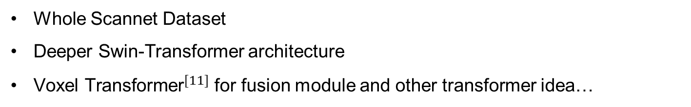
Contributions
Hierarchical Swin-Transformer feature extraction module that extracts most informative features for downstream tasks
Transformer based local feature fusion module that enables real time and accurate 3D scene reconstruction
Further Works
Whole Scannet Dataset
Deeper Swin-Transformer architecture
${\text{Voxel} \text{Transformer}}^{[11]}$ for fusion module and other transformer idea…
[11] Mao J, Xue Y, Niu M, et al. Voxel transformer for 3d object detection[C]//Proceedings of the IEEE/CVF International Conference on Computer Vision. 2021: 3164-3173.
Notes:
in general, I think our first contribution is to propose a Hierarchical Swin-Transformer feature extraction module that extracts most informative features for downstream tasks, second one is a transformer based local feature fusion module that enables real time and accurate 3D scene reconstruction
There are still a lot can be done to our project. Training our network under the whole Scannet dataset, using a deeper swin-transformer architecture or trying voxel transformer are all promising.
In fact, we have tried many other methods, but this method has the best overall performance and speed under current hardware conditions
An idea we consider to implement is to input the local windows of onescene into transformer and let transformer determine which information to keep and which to discard and predict whole scene directly, but due to limited hardware and time it’s difficult to compute attention between such large sequences.
transformerfusion queries 2D features in images and predict fused 3D features using transformer network, but for us, the inputs of transformer are both 3D features, they also use attention result for view selection

Slide 15
Thanks!
Notes:
That’s all about our project, we are open for questions!

